Slide 1
Class And Object
By
Anusha Bellala

Slide 2
Declaration of class
Generally, a class declaration contains only keyword class, followed by an identifier(name) of the class. But there are some optional attributes that can be used with class declaration according to the application requirement. In general, class declarations can include these components, in order:
Modifiers: A class can be public or internal etc. By default modifier of class is internal.
Keyword class: A class keyword is used to declare the type class.
Class Identifier: The variable of type class is provided. The identifier(or name of class) should begin with a initial letter which should be capitalized by convention.

Slide 3
Base class or Super class: The name of the class’s parent (superclass), if any, preceded by the : (colon). This is optional.
Interfaces: A comma-separated list of interfaces implemented by the class, if any, preceded by the : (colon). A class can implement more than one interface. This is optional.
Body: The class body is surrounded by { } (curly braces).
Constructors in class are used for initializing new objects. Fields are variables that provide the state of the class and its objects, and methods are used to implement the behavior of the class and its objects.
Example:
// declaring public class
public class Program {
// field variable
public int a, b;
// member function or method
public void display()
{ Console.WriteLine(“Class & Objects in C#”); } }

Slide 4
Objects
It is a basic unit of Object-Oriented Programming and represents the real-life entities. A typical C# program creates many objects, which as you know, interact by invoking methods. An object consists of :
State: It is represented by attributes of an object. It also reflects the properties of an object.
Behavior: It is represented by methods of an object. It also reflects the response of an object with other objects.
Identity: It gives a unique name to an object and enables one object to interact with other objects.

Slide 5
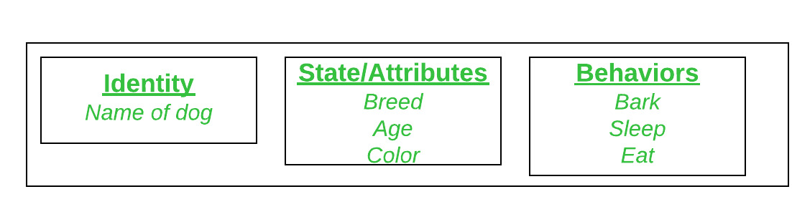
Example:
Consider Dog as an object and see the below diagram for its identity, state, and behavior.

Slide 6
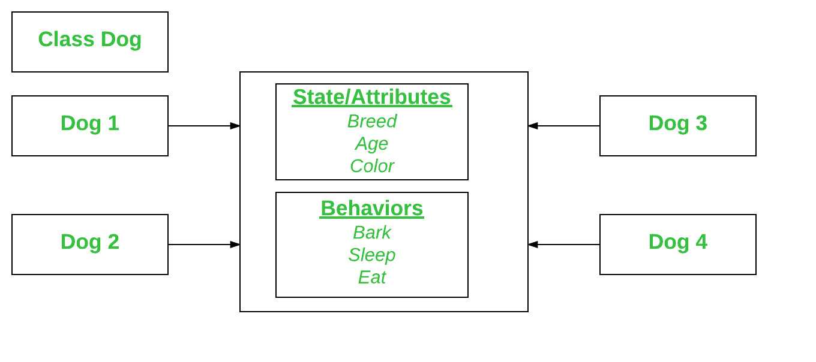
Declaring Objects (Also called instantiating a class):
When an object of a class is created, the class is said to be instantiated. All the instances share the attributes and the behavior of the class. But the values of those attributes, i.e. the state are unique for each object. A single class may have any number of instances.
Example:

